Slide 1




Presented by Sima mishra
CODEBASICS SQL PROJECT CHALLENGE
Ad_Hoc Insights
Consumer Goods

Slide 2
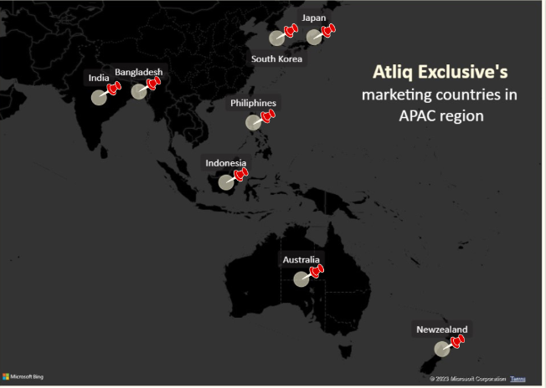

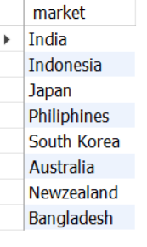
CODEBASICS SQL PROJECT CHALLENGE
TASK-1
Provide the list of markets in which customer "Atliq Exclusive" operates its business in the APAC region.

Slide 3

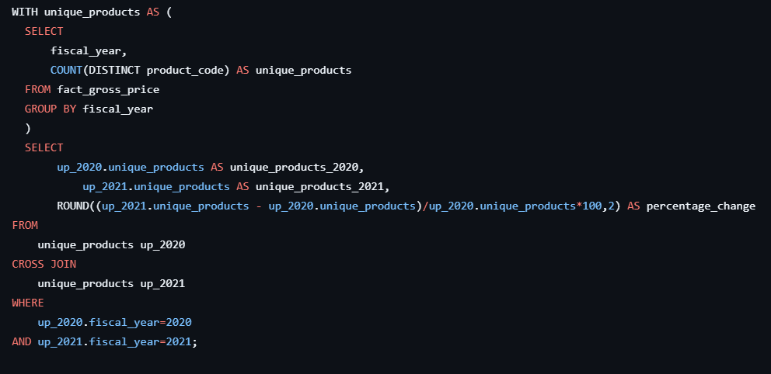
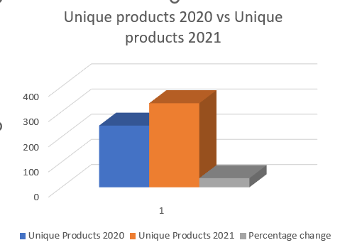
TASK-2
What is the percentage of unique product increase in 2021 vs. 2020? The final output contains these fields unique_products_2020
,unique_products_2021,percentage_chg

Slide 4
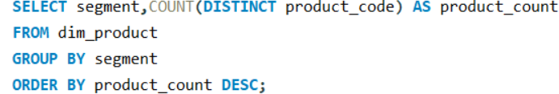
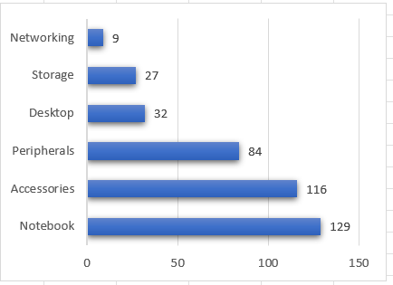
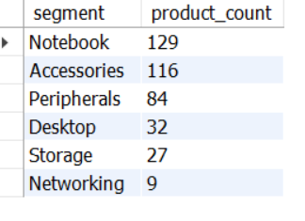
TASK-3
Provide a report with all the unique product counts for each segment and sort them in descending order of product counts. The final output contains 2 fields, -- segment -- product_count

Slide 5
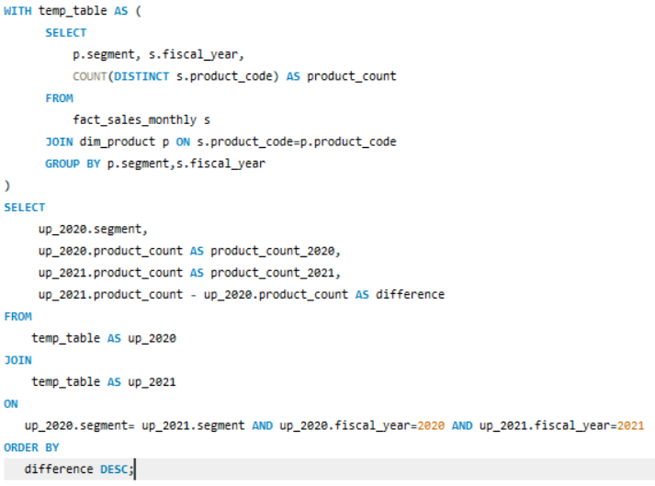
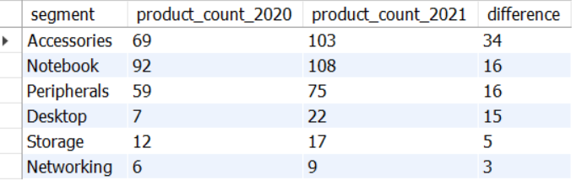
TASK-4
Follow-up: Which segment had the most increase in unique products in 2021 vs 2020? -- The final output contains these fields, segment , product_count_2020 , product_count_2021 , difference

Slide 6
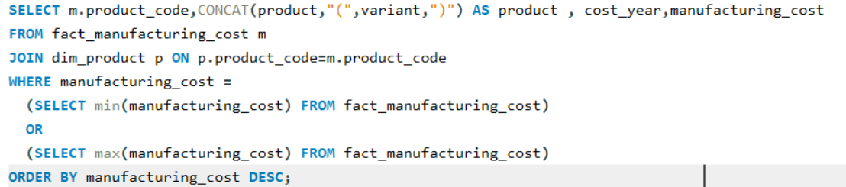
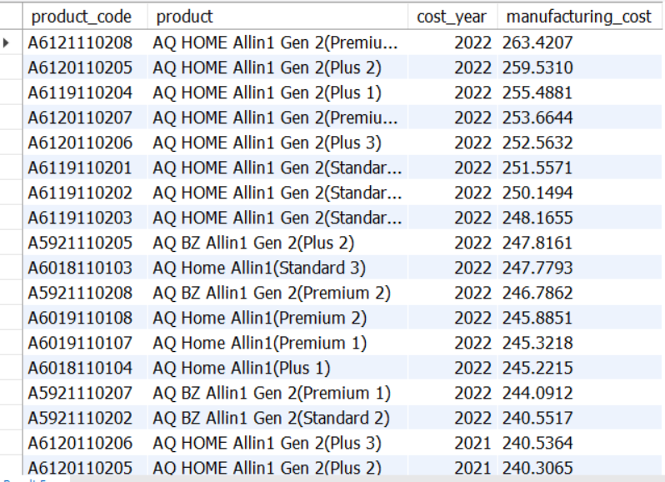
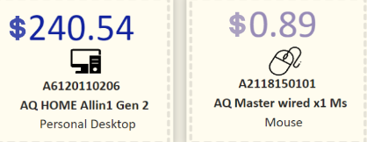
TASK-5
Get the products that have the highest and lowest manufacturing costs. The final output should contain these fields, product code , product , manufacturing cost

Slide 7
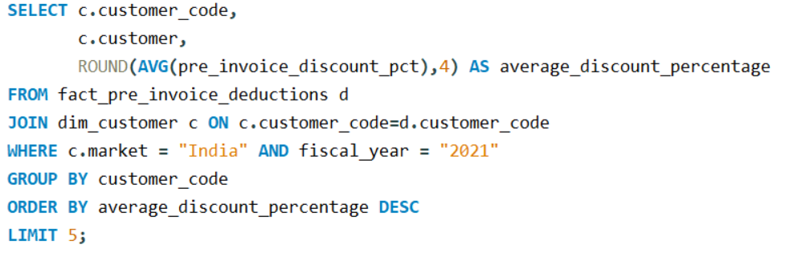
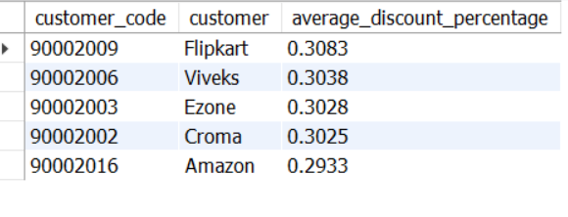
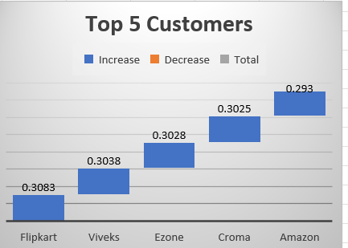
TASK-6
Generate a report which contains the top 5 customers who received an average high pre invoice discount pct for the fiscal year 2021 and in the Indian market. The final output contains these fields, customer code ,customer , average discount percentage.

Slide 8
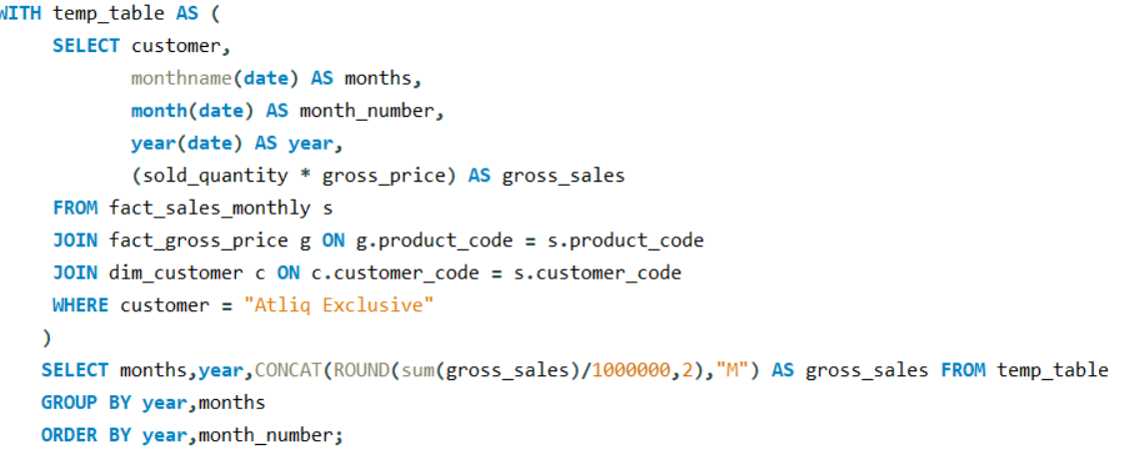
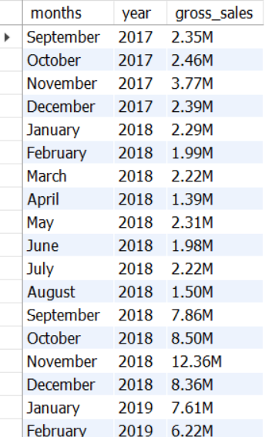
TASK-7
Get the complete report of the Gross sales amount for the customer “Atliq Exclusive” for each month .This analysis helps to get an idea of low and high-performing months and take strategic decisions. The final report contains these columns: Month ,Year ,Gross sales Amount

Slide 9
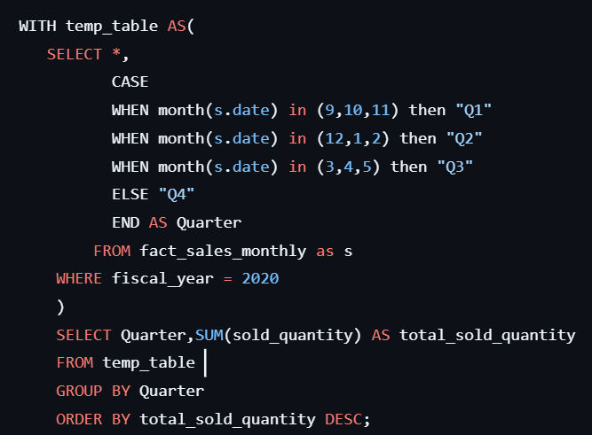
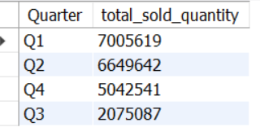
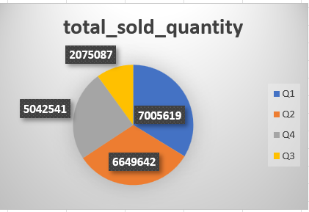
TASK-8
In which quarter of 2020, got the maximum total sold quantity? The final output contains these fields sorted by the total sold quantity, Quarter ,total sold quantity

Slide 10
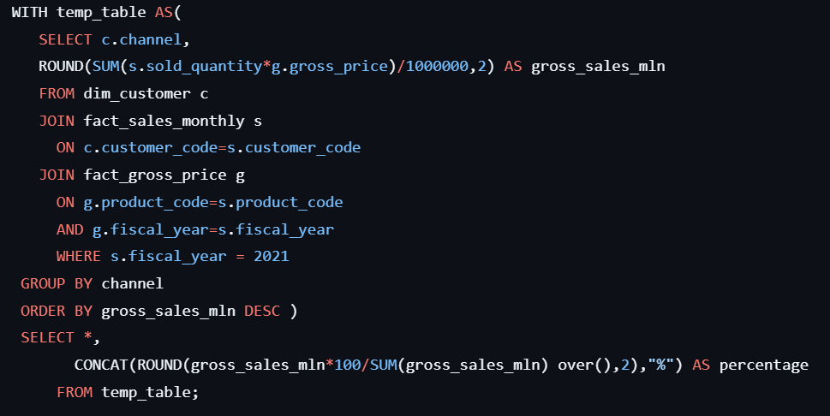
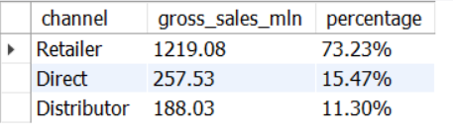
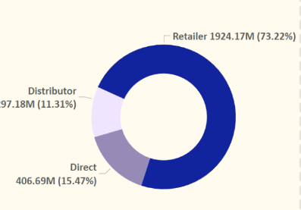
TASK-9
Which channel helped to bring more gross sales in the fiscal year 2021 and the percentage of contribution? The final output contains these fields, channel ,gross sales mln ,percentage

Slide 11
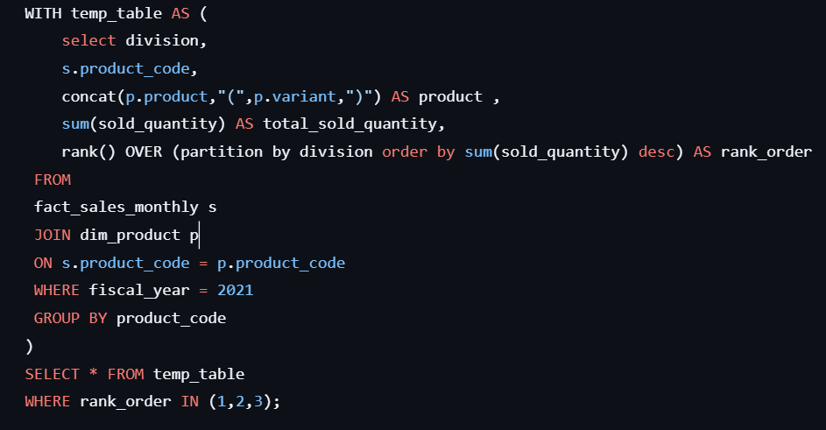
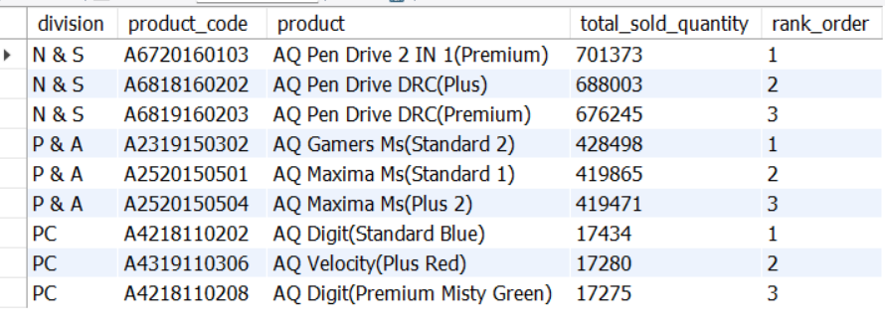
TASK-9
Get the Top 3 products in each division that have a high total sold quantity in the fiscal year 2021? The final output contains these fields, division ,product code

